Slide 1
Ethical issues in Medical Practice
By
Dr.Jagadeesh.N
MBBS, MD, DNB, LLB, PGDMLE
*Professor & HOD of Forensic Medicine
Vydehi Institute of Medical Sciences
Bangalore, Karnataka, INDIA
*Hon. Consultant, CEHAT, Mumbai

Slide 2
Outline
Let’s learn Ethical issues in Medical Practice
Please comment on the role of Doctor

Slide 3
Case study

Slide 6

.

Slide 7
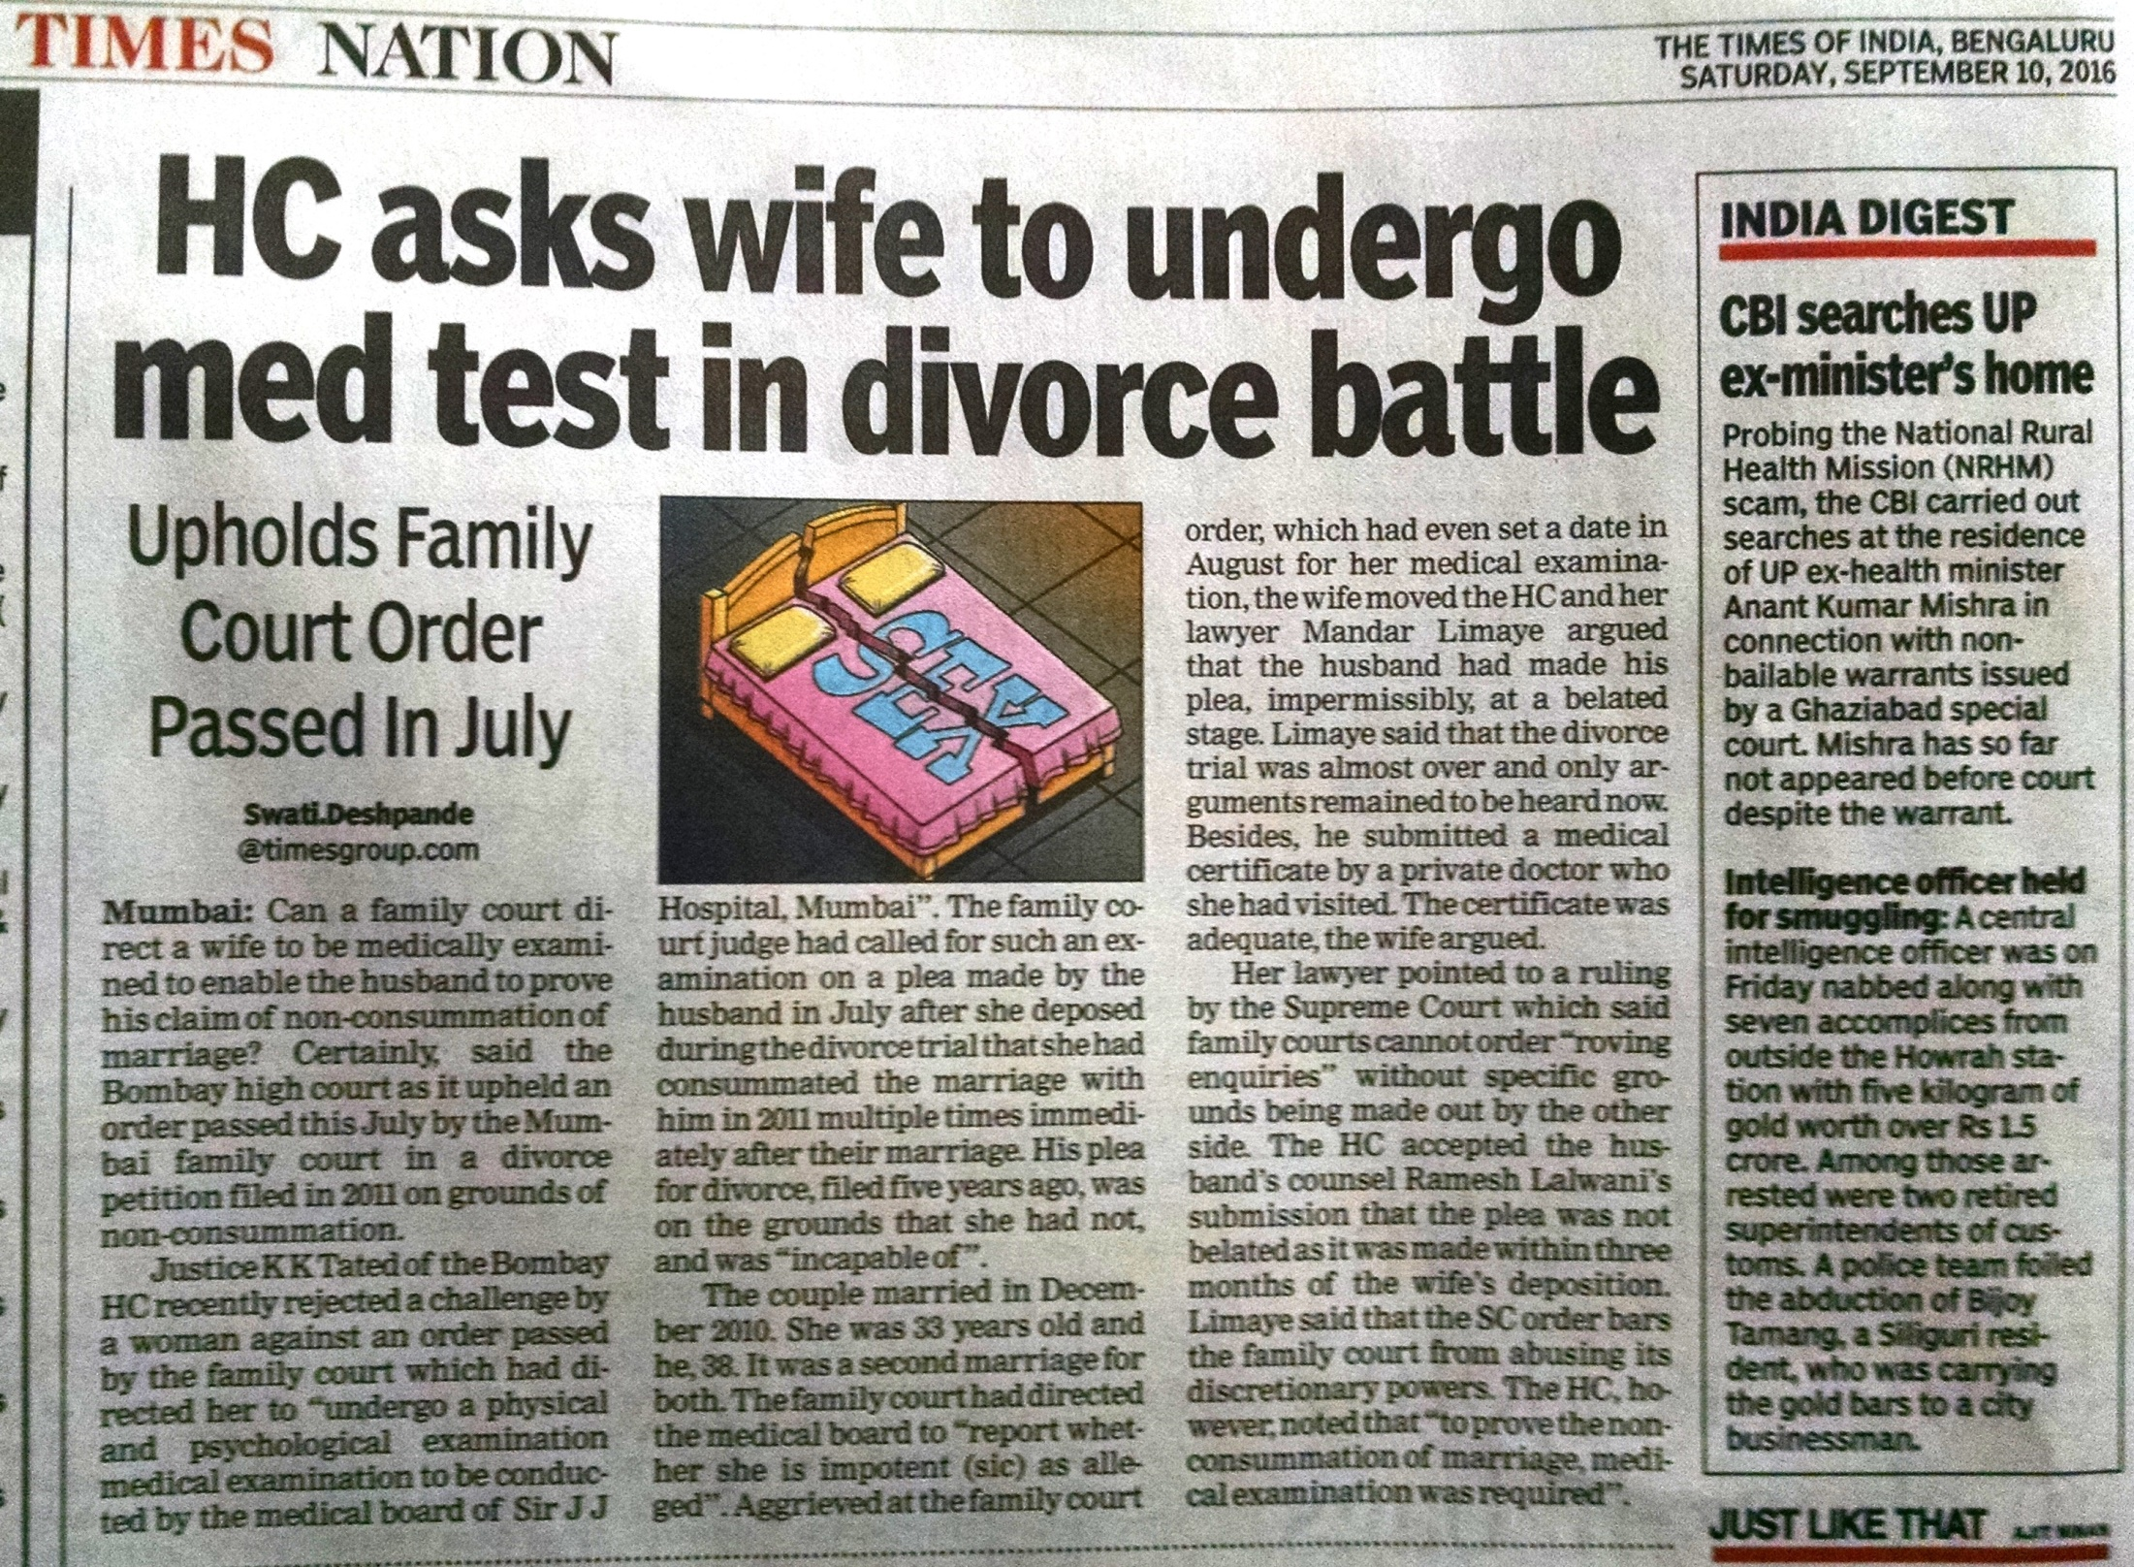
Issues with Virginity & Defloration

Slide 8
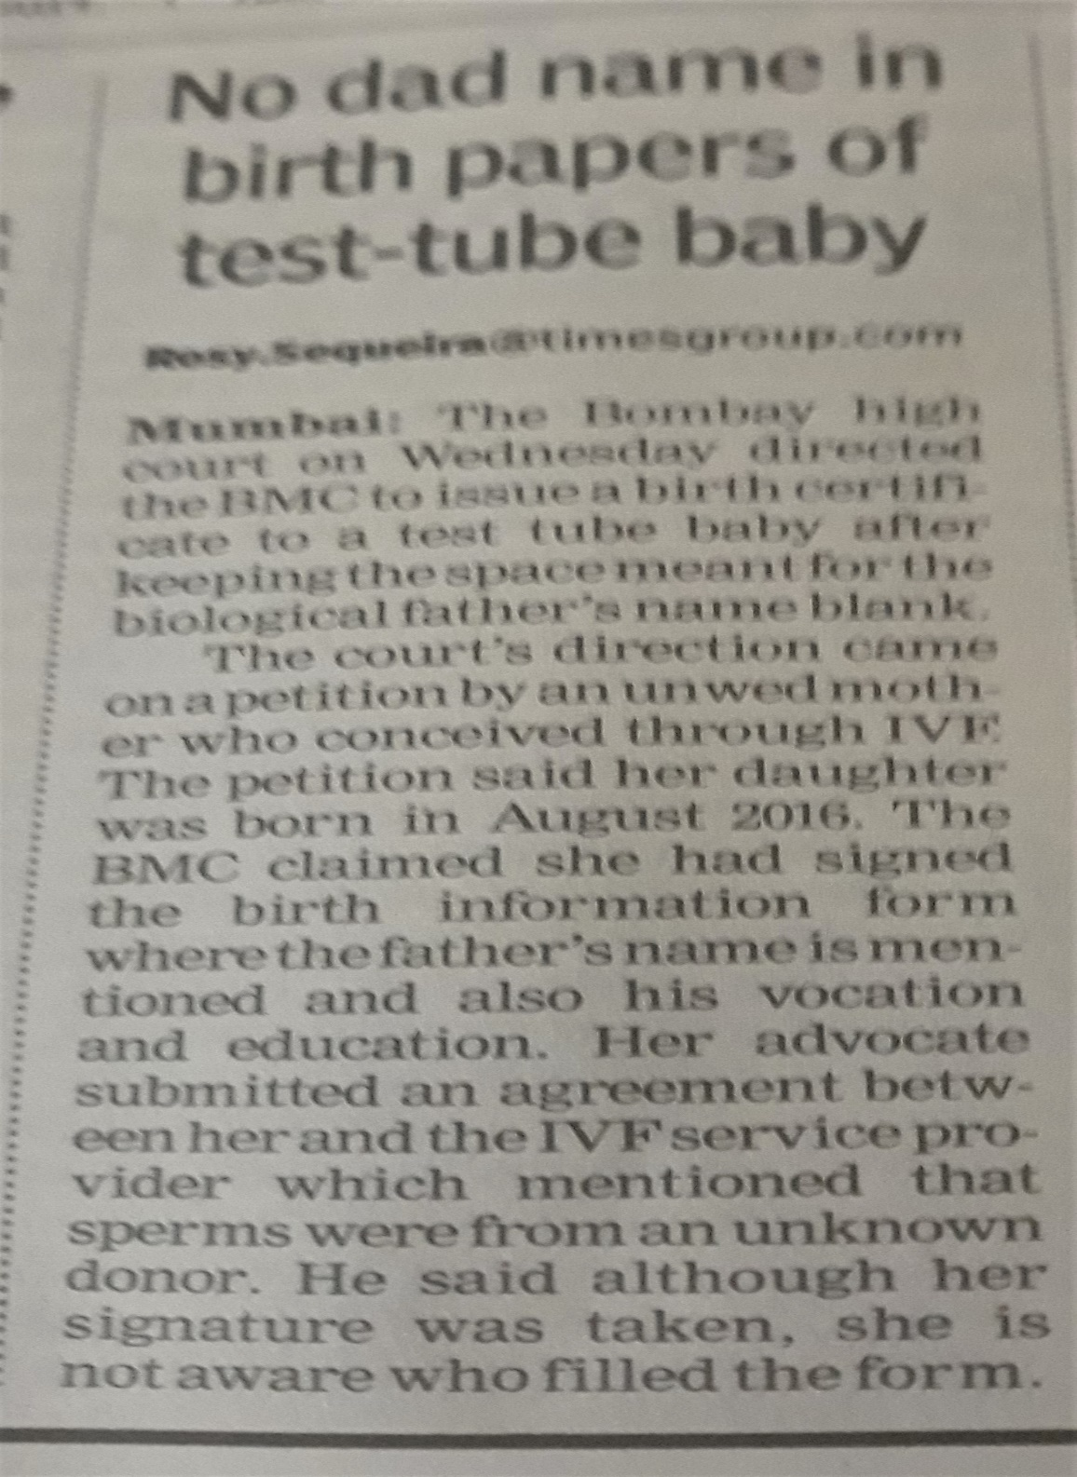

Slide 9
To Conclude………..
Ethical issues in Medical Practice
Informed consent
Confidentiality
Privacy
Justice – Resources / Access
Sensitivity – Prevent Revictimisation
Patience ……. Time……. Empathy v Sympathy

Slide 10

Thank You email – forensicjagadeesh@gmail.com

